Slide 1
Session 1

Slide 2
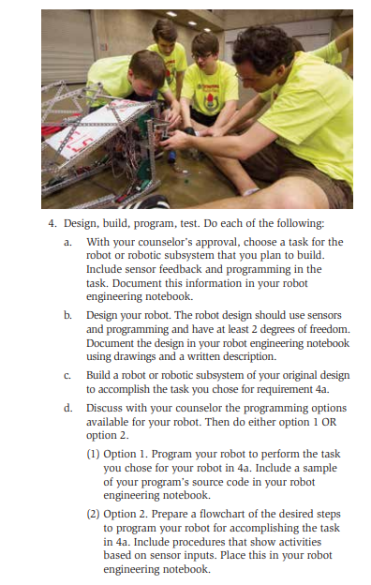
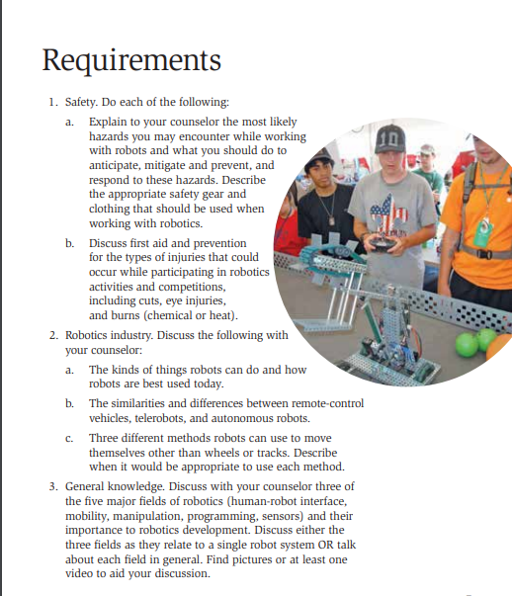
This session will cover:
This session will cover:

Slide 3
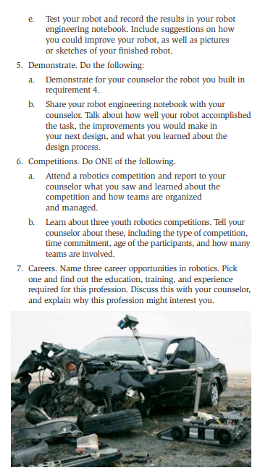

Slide 4
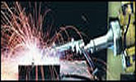
Occupational Safety and Health Administration (OSHA)
Robotics
Studies indicate that many robot accidents occur during non-routine operating conditions, such as programming, maintenance, testing, setup, or adjustment. During many of these operations the worker may temporarily be within the robot's working envelope where unintended operations could result in injuries.

Slide 5
Robotic Safety
SOLDERING
Soldering can be dangerous because of the heat from the iron and the chemical fumes and vapors released from the solder and flux, respectively. When soldering, observe the following points:
Wear eye and face protection.
Solder in well-ventilated areas.
Never touch the iron/gun. It heats to extreme temperatures that will cause severe burns. Wear cotton clothing that covers your arms and legs. Keep your soldering iron in its protective holder when not actually being used.
Always wash your hands with soap and water after handling solder.
Do not leave any hot tools, where someone can accidentally contact the hot element. ALWAYS ASSUME IT’S HOT!!!!

Slide 6
Robotic Safety
STORED ENERGY
Plan out the required activities when servicing or making repairs to the robot. Make sure all teammates are aware that work is being done on the robot. Address the following:
Ensure no one is working on the robot when it will be energized during repairs.
Electrical Energy: Disconnect the electric power source
Always de-energize the robot before working on it by unplugging batteries. Open the main circuit breaker (“re-set” lever is released).
Pneumatic Energy: Always vent any compressed air to the atmosphere.
Relieve any compressed or stretched springs or tubing and lower all raised components.

Slide 7
Robotic Safety
BATTERY SAFETY
CAUTION: Batteries contain acid. This substance, H2SO4, is a corrosive, colorless liquid that will burn your eyes, skin, and clothing.
Any battery that is visibly damaged in any way is dangerous and unusable, and should be set aside and handled accordingly.
Care must be taken when recharging batteries. Hydrogen can build up and explode.
First Aid: Neutralize it by pouring the sodium bicarbonate (baking soda) on all wetted surfaces.

Slide 8

Robotic Safety – First Aid
Injury | First Aid
Cuts - small | Wear gloves Wash – Neosporin - Bandage
Cuts - large | Clean, bandage, apply pressure
Eye Injury - Foreign object or Chemical | Flush with water
Burn - Heat | Wash in cold water – Apply Ice – Apply Aloe
Burn - Chemical | Wash site thoroughly with soap and water
Robot becomes self aware | Have "Fail Safe" shut down switch
You become enslaved by robot | "Obey" then Plan rebellion
*** Call 911 or seek medical attention if injury is serious ***

Slide 9
Engineering Notebook
An Engineering Notebook is a place to document your ideas and work.
It is a legal document
It can be used for Patents and Legal
Each entry should be dated
It should have references, contacts, drawings, formulas, empirical results, etc.

Slide 10
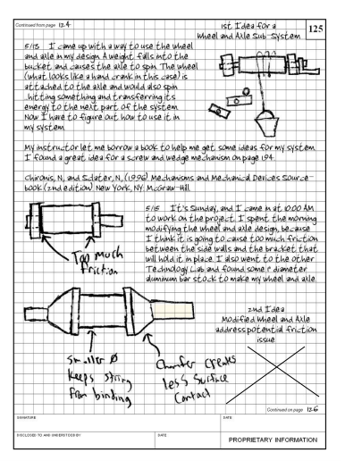
Your Engineering Notebook Should Contain
A description of the problem you are solving
Design ideas
List of components
Circuit Diagram
Drawings of your robot
Code listings
Experiments (challenges) and their results
Your observations
Short Summary of the project

Slide 11
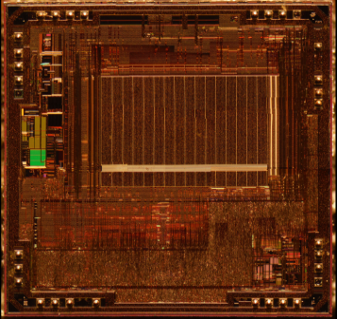
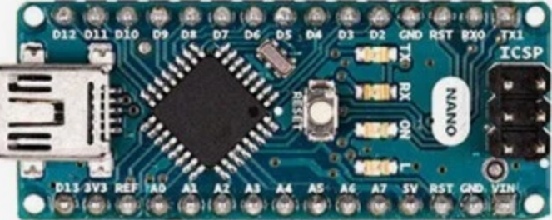
The ParksBot 100 Computational Power to solve all our problems
What is it:
An Arduino Nano
AtMega328
The high-performance Microchip picoPower 8-bit AVR RISC-based microcontroller combines 32KB ISP flash memory, 2KB SRAM, 23 general purpose I/O lines, 32 general purpose working registers, serial programmable USART, a 6-channel 10-bit A/D converter, The device operates at 5.5 volts @ 16MHz.
What we’ll learn:
Setup our software for programming
Basic Arduino programming
How to write a function
Controlling LEDs

Slide 12
Software Installation
Arduino IDE
https://www.arduino.cc/en/main/software
CH340 Serial Drivers
Windows CH340 Driver
Macintosh Drivers for CH340 Driver

Slide 13
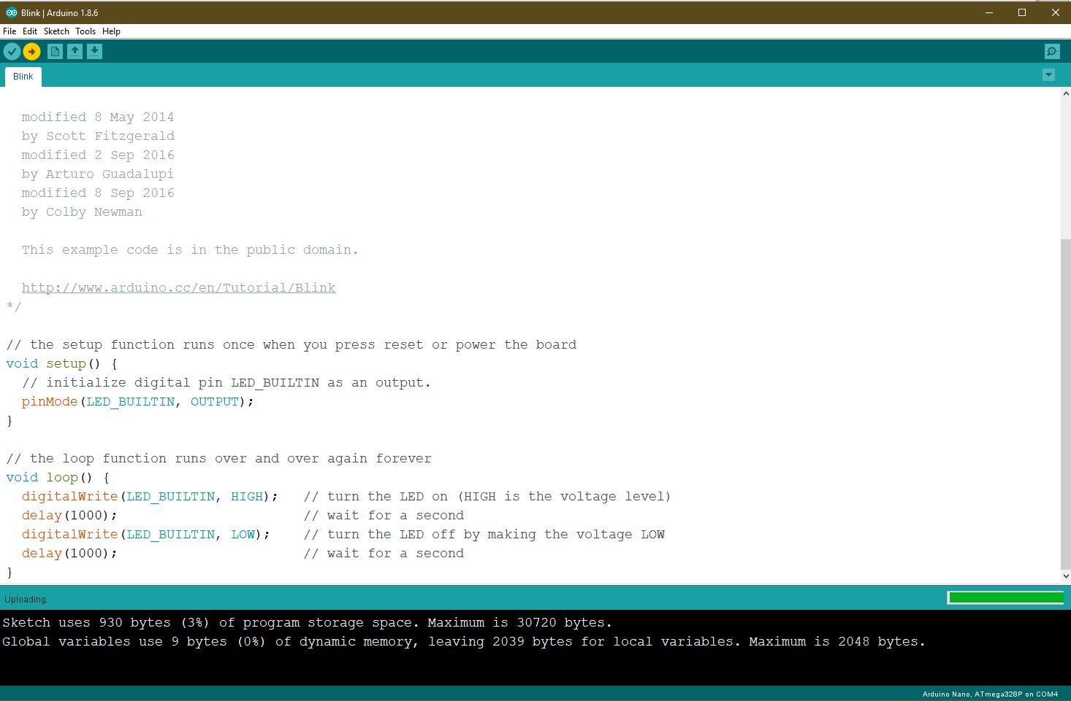
Arduino IDE
Test your connection with Blink
Look under File->Examples->Basic->Blink

Slide 14
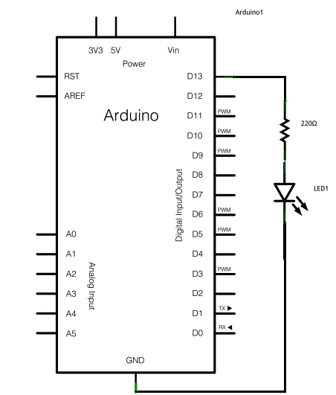
Blink Program
void setup() {
// initialize digital pin LED_BUILTIN as an output.
pinMode(LED_BUILTIN, OUTPUT);
}
void loop() {
digitalWrite(LED_BUILTIN, HIGH);) delay(1000);
digitalWrite(LED_BUILTIN, LOW); delay(1000);
}

Slide 15
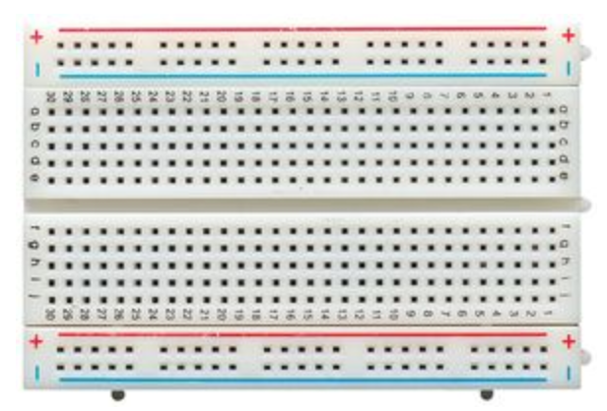
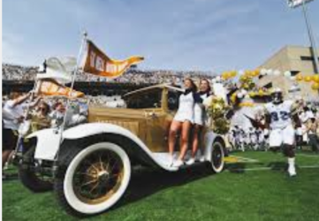
The ParksBot 100:
Specializes in computational abilities
And will provide the brains of our project
Challenge:
Can you make a function that turns on the LED for a given number of ms?
Blinking
Light
Challenge:
Can you make the ParksBot signal SOS?
What we’ll learn:
Setup our software for programming
Basic Arduino programming
Controlling LEDs
The ParksBot thinks a lot, but doesn’t
Move. You might call it a Ramblin Wreck!

Slide 16
Session 2

Slide 17

Our progress

Slide 19
Fields of Robotics
Human-Robot Interface
Mobility – Movement
Manipulation – interacting with the environment
Programming – robotic control and functionality
Sensors – real world feedback

Slide 20
Home Work
Find two toothbrushes (can be used)
Cut off the head of the toothbrush
Pick a field of robotics to discuss with your counselor.
Find an image that aids in your discussion
Update your engineering note book
Try to add the Right Sonar to the robot.
Define where the wires go (VCC, GND, Trig, Echo)
Modify the code to read from both the right and left sonar.

Slide 21
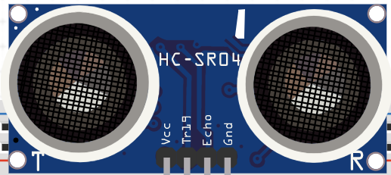
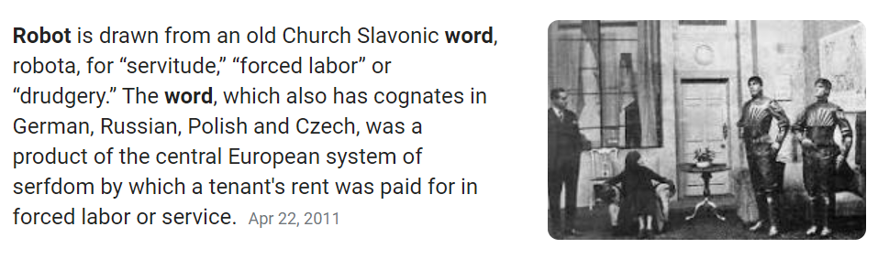
The SauerBot 200 Using Sonic Technology to Geo-Caching
What is it:
HC-SR04 Sonic Depth Sensor
Uses sound to measure distance to objects
The SauerBot is not powered by Mountain Dew
What we’ll learn:
How a sonic sensor works
How to add library’s for Arduino
How to use a serial monitor
How to use if statments

Slide 22
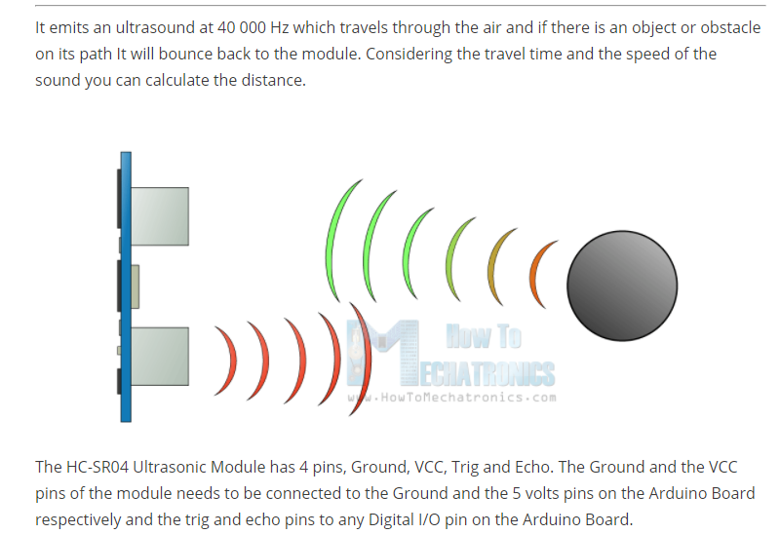
The HC SR04 Sonic Sensor

Slide 23
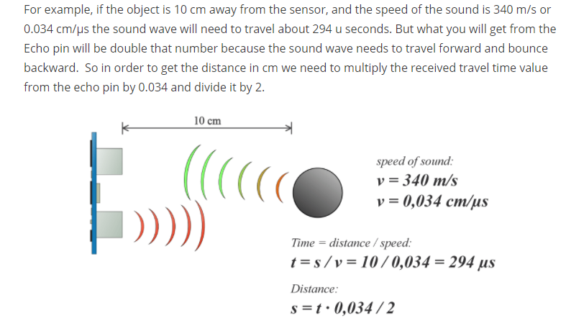
Using the Sonic Sensor

Slide 24
Document in your Engineering Journal
Circuit diagrams
Code
Tests

Slide 25
Bread Board Connectivity
Jumpers plugged into
The board are connected to other jumpers plugged into the same green aligned holes

Slide 26
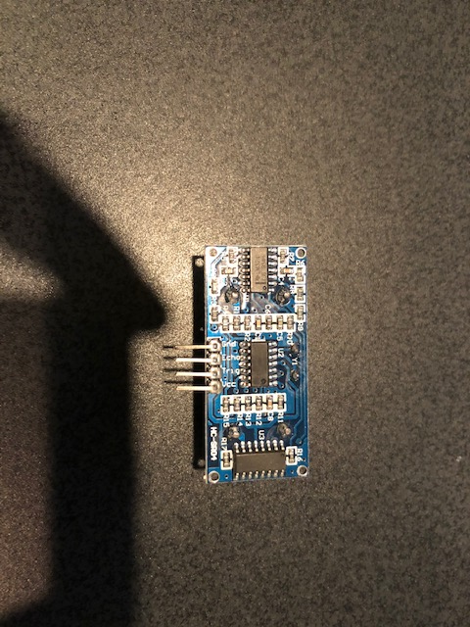
Bread Board Connectivity
Jumpers plugged into
The board are connected to other jumpers plugged into the same green aligned holes

Slide 27
The SauerBot 200 Using Sonic Technology to Geo-Cache
Left Forward
Challenge:
Right Forward
Can you figure out the circuit for adding a sensor on the right?
Back

Slide 28
Programming the HC SR04
#include <NewPing.h>
const int LEFT_SENSOR_TRIG_PIN=11;
const int LEFT_SENSOR_ECHO_PIN=12;
const int MAX_DISTANCE=200; // max distance in cm
NewPing LeftSonar(LEFT_SENSOR_TRIG_PIN,LEFT_SENSOR_ECHO_PIN,MAX_DISTANCE);
void setup() {
// put your setup code here, to run once:
Serial.begin(115200);
delay(5000);
}
void loop() {
// put your main code here, to run repeatedly:
int LeftDistance=LeftSonar.ping_cm();
Serial.print("Left Ping: ");
Serial.print(LeftDistance);
Serial.println("cm");
delay(1000);
}

Slide 29
Session 3

Slide 30
Our progress

Slide 32
Robotic Competitions
B.E.S.T Robotics Design Contest
Botball Educational Robotics Program
FIRST: Robotics Competition
FIRST: Tech Challenge
National Robotics Challenge
Descriptions of these competitions:
https://blog.collegevine.com/5-robotics-competitions-for-high-schoolers/

Slide 33
The SauerBot 300 Using Dual Sonic Technology to Geo-Cache
Left Forward
Right Forward
Challenge:
Can you print if the Geo-Cache is on the right or left?
Back

Slide 34
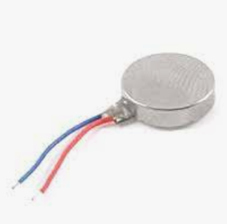
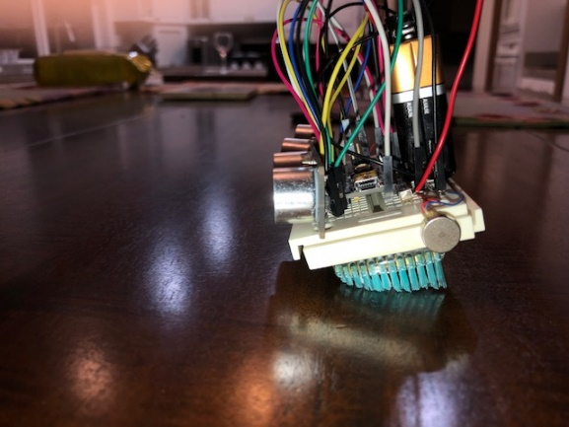
The crAshley 400 Clears the way for others to follow!
What is it:
A Bristle Bot
2 DC 3V 12000RPM Micro Flat Vibration Motor
Uses vibrating bristles for locomotion
Able to crash into objects easily
What we’ll learn:
Using Pulse Width Modulation to control analog devices
How to trim the toothbrush bristles to promote locomotion
How to create locomotion for a bristle bot
How to tune a bristle bot’s steering
Trim Bristles to form a slant

Slide 35
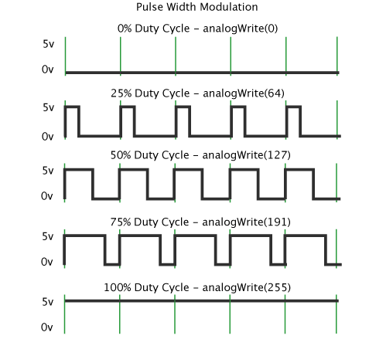
Pulse Width Modulation
As its name suggests, pulse width modulation speed control works by driving the motor with a series of “ON-OFF” pulses and varying the duty cycle, the fraction of time that the output voltage is “ON” compared to when it is “OFF”, of the pulses while keeping the frequency constant.
What width would we program for 3V for our Motor?
AnalogWrite(177) ~ 3V
5V On
177
78
177
78
177
78
255/5v * 3v => 177
Average 3V
0V Off

Slide 36
Left Forward
Right Forward
Basic Motor Circuit Only
Back

Slide 37
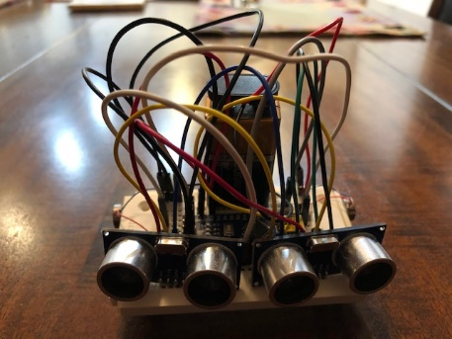
What Our Robot Looks Like with Sensors and a Motor
Left Forward
Right Forward
Back

Slide 38

Left Forward
What Our Robot Looks Like with Both Sensors and Both Motors
Right Forward
Back

Slide 39
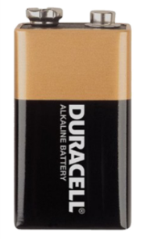
Left Forward
Right Forward
Back

Slide 40
Locomotion Code
#define RIGHT_MOTOR_PIN 5
#define LEFT_MOTOR_PIN 6
#define LEFT_VIBRATE 150
#define RIGHT_VIBRATE 150
#define VIBRATE 150
#define NO_VIBRATE 0
void setup() {
Serial.begin(115200); // Open serial monitor at 115200 baud to see ping results.
pinMode(RIGHT_MOTOR_PIN, OUTPUT);
pinMode(LEFT_MOTOR_PIN, OUTPUT);
delay(5000);
}
void standStill(int seconds) {
analogWrite(RIGHT_MOTOR_PIN, NO_VIBRATE);
analogWrite(LEFT_MOTOR_PIN, NO_VIBRATE);
Serial.println("stop");
delay(seconds * 1000);
}
void goForward(int seconds) {
analogWrite(RIGHT_MOTOR_PIN, RIGHT_VIBRATE);
analogWrite(LEFT_MOTOR_PIN, LEFT_VIBRATE);
Serial.println("go forward");
delay(seconds * 1000);
standStill(0);
}
void turnRight(int seconds) {
….
}
void turnLeft(int seconds) {
…..
}
void calibrateMovement() {
goForward(5);
standStill(5);
goForward(5);
standStill(5);
goForward(5);
standStill(5);
goForward(5);
standStill(5);
turnLeft(5);
standStill(5);
turnLeft(5);
standStill(5);
turnRight(5);
standStill(5);
turnRight(5);
while (1) {};
}
void loop() {
calibrateMovement();
}
Challenge:
Can you get your crAshley to go straight?
Challenge:
Can you write the functions for turnRight and turnLeft?

Slide 41
Session 4

Slide 43
Robotics Careers
The career choices for robotics are almost endless but here are a few examples
- Automotive Industry
- NASA
- Boston Dynamics
- Software Engineering
- Consumer Markets
- Household robots
- Prosthetics
- Military

Slide 44
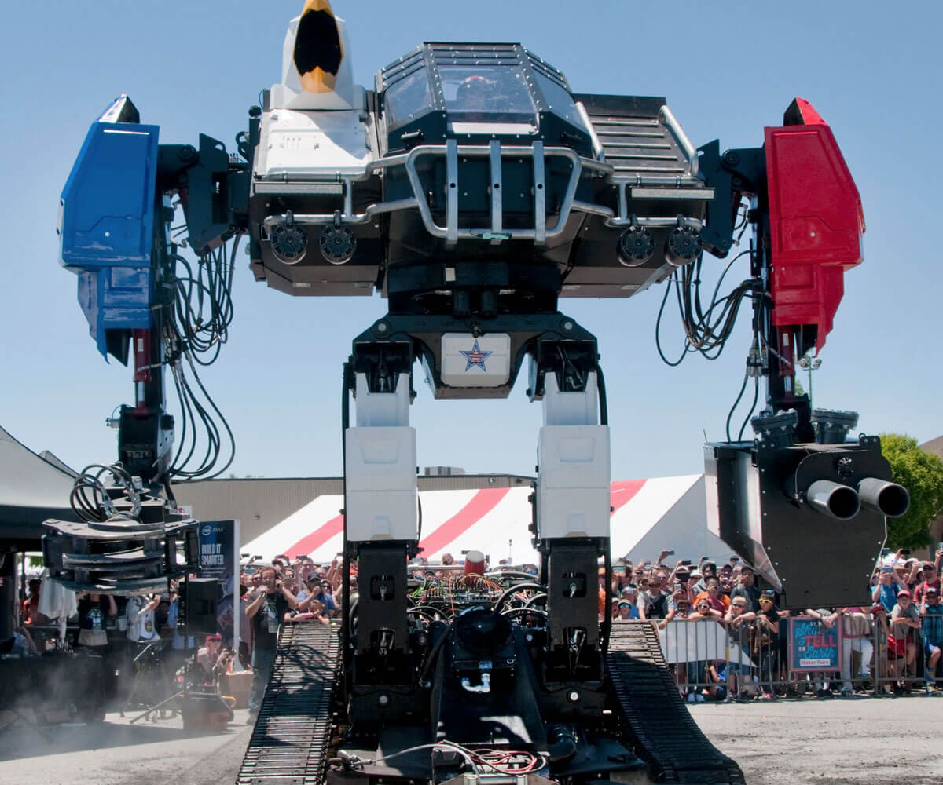
Education for a Robotics Career
Electrical Engineering (Sensors, computation)
Control Systems (Mobility)
Computer Engineering (Programming, computation, human-robot interface)
Robotic Engineering (human-robot interface, system integration)
Computer Science (Programming, AI, ML)
Mechanical Engineering (manipulators, mobility)
Bio-Medical Engineering (medical robots)
OSU Collaborative Robotics Institute
https://www.youtube.com/watch?v=zauYACP2lOc

Slide 45
Left Forward
What Our Robot Looks Like with Both Sensors and Both Motors
Right Forward
Back

Slide 46
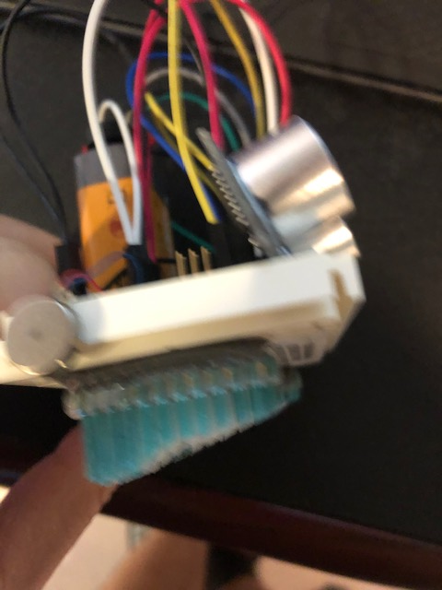
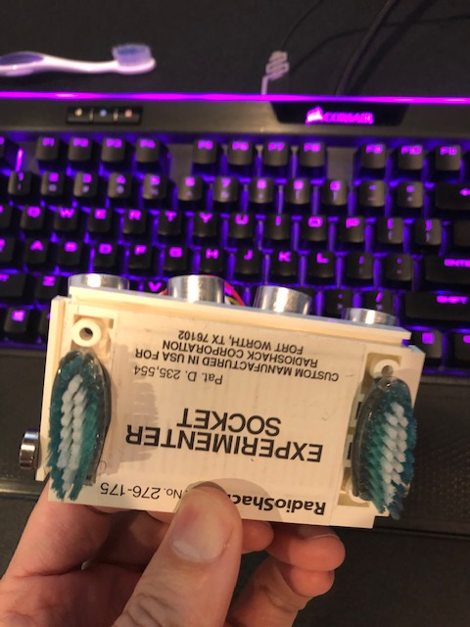
Toothbrush Locomotion (BristleBot)
HARD brush heads work best
Trim the bristles to be at an angle
Place the brushes in parallel

Slide 47
Session 5

Slide 48
Our progress

Slide 50

Put all the tech of the ParksBot, Sauerbot, and crAshleyBot into one and what do you get? The FischBot 500 Able to navigate the challenges
What is it:
An autonomous robot
Utilizes depth sensors and locomotion to avoid obstacles
What we’ll learn:
Algorithms for Obstacle avoidance
How to debug
Challenges in navigation

Slide 51
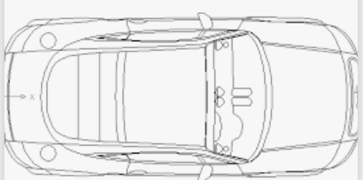
FischBot Navigation
Forward
Stop
WALL
Left
Sensor
Right
Sensor
Left
Sensor
Right
Sensor
if an obstacle is really close to both the right and left sensor stop
if an object isn’t close go forward

Slide 52
FischBot Navigation
Turn Left
Turn Right
WALL
WALL
Left
Sensor
Right
Sensor
Left
Sensor
Right
Sensor
if an object is close to the right sensor turn left
if an object is close to the left sensor turn right

Slide 53
What’s a Conditional Statment
In English
IF the distance is less than a mile then I’ll walk
ELSE if the distance is less than five miles then I’ll take a bus
ELSE if the distance is less than 100 miles then I’ll drive a car
ELSE take a plane
Examples in Arduino (C Language):
if (condition) {
Action;
}else if (condition) {
Action;
}else {
Action;
}
Condition
Action
If(distance<1){
Serial.println(“let’s walk”);
}else if (distance<5){
Serial.println(“let’s take a bus”);
}else if (distance<100){
Serial.println(“let’s drive”);
else{
Serial.println(“Let’s fly!!”);
}

Slide 54
STOP
Stop
If an object is closer than the COLLISION_DISTANCE in either the right or left side, then stop
Left
Sensor
Right
Sensor
COLLISION_DISTANCE is the distance in which the object is too close to steer around to avoid.
By experiment this is about 3cm
COLLISION_DISTANCE
WALL
3cm
Code
const in COLLISION_DISTANCE=3;
If ((RightDistance<COLLISION_DISTANCE) ||
(LeftDistance<COLLISION_DISTANCE)){
StandStill(1);
}
|| symbol represent logical OR

Slide 55
RIGHT TURN
TURNING_DISTANCE is the distance in which the robot needs to begin turning to steer around the object
By experiment this is about 15cm
Right
Sensor
Left
Sensor
TURNING_DISTANCE
WALL
COLLISION_DISTANCE
If an object is within TURNING_DISTANCE on the right side, then turn left
Code
const int TURNING_DISTANCE=15;
If (RightDistance<TURNING_DISTANCE){
GoLeft(3);
}
if an obstacle is really close to both the right and left sensor stop

Slide 56
LEFT TURN
TURNING_DISTANCE is the distance in which the robot needs to begin turning to steer around the object
By experiment this is about 15cm
Right
Sensor
Left
Sensor
TURNING_DISTANCE
WALL
COLLISION_DISTANCE
If an object is within TURNING_DISTANCE on the left side, then turn right
Code
If (LeftDistance<TURNING_DISTANCE){
GoRight(3);
}
if an obstacle is really close to both the right and left sensor stop

Slide 57
FORWARD
If we aren’t turning left, right, or stopping, then there are no objects. Go forward!!
Right
Sensor
Left
Sensor
TURNING_DISTANCE
No objects
COLLISION_DISTANCE
Code
GoForward(2);
if an obstacle is really close to both the right and left sensor stop

Slide 58
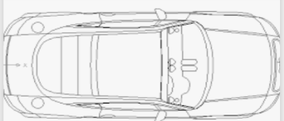
Putting It All Together
Stop
If ((RightDistance<COLLISION_DISTANCE) ||
(LeftDistance<COLLISION_DISTANCE)){
StandStill(1);
}
TURNING_DISTANCE
Left
Sensor
Right
Sensor
}else If (RightDistance<TURNING_DISTANCE){
GoLeft(3);
}
}else If (LeftDistance <TURNING_DISTANCE){
GoRight(3);
}
COLLISION_DISTANCE
}else{
GoForward(2);
}

Slide 59

Tune and Demonstrate your Robot
Challenge:
Challenge:
Can you tune your robot to go straight?
Left?
Right?
Can you get your FischBot to navigate through a series of obstacles?
Super Challenge:
Can you write code such that your FischBot tries to travel in the same direction while avoiding obstacles?
How would you do it?

Slide 60
BACKUP

Slide 61
Uninstalling From Macinstosh
A couple of Mac users have said “the driver crashes my mac Sierra how do I uninstall”.
Firstly regards the crash make sure you installed the 1.3 version of the driver, not the old one. You could download it directly from the Manufacturers Website in case they have issued an update since I wrote this page.
Secondly a quick google search reveals that this is how you uninstall:
Open a terminal and type: cd /Library/Extensions/
Verify that the .kext file is present: ls | grep usbserial.kext
Output should be: usbserial.kext
Then type: sudo rm -R usbserial.kext
Verify that the .kext file has been removed: ls | grep usbserial.kext
Output should be empty.
After you should remove the files stored in receipts folder: cd /private/var/db/receipts/
Find the enties: ls | grep usbserial*
Output should be: codebender.cc.ch34xinstaller.usbserial.pkg.bom codebender.cc.ch34xinstaller.usbserial.pkg.plist
Remove each one of the files of the above list: sudo rm -r filename`

Slide 62
Locomotion Code
#define RIGHT_MOTOR_PIN 5
#define LEFT_MOTOR_PIN 6
#define LEFT_VIBRATE 150
#define RIGHT_VIBRATE 150
#define VIBRATE 150
#define NO_VIBRATE 0
void setup() {
Serial.begin(115200); // Open serial monitor at 115200 baud to see ping results.
pinMode(RIGHT_MOTOR_PIN, OUTPUT);
pinMode(LEFT_MOTOR_PIN, OUTPUT);
delay(5000);
}
void standStill(int seconds) {
analogWrite(RIGHT_MOTOR_PIN, NO_VIBRATE);
analogWrite(LEFT_MOTOR_PIN, NO_VIBRATE);
Serial.println("stop");
delay(seconds * 1000);
}
void turnLeft(int seconds) {
analogWrite(RIGHT_MOTOR_PIN, VIBRATE);
analogWrite(LEFT_MOTOR_PIN, NO_VIBRATE);
Serial.println("turn left");
delay(seconds * 1000);
standStill(0);
}
void turnRight(int seconds) {
analogWrite(RIGHT_MOTOR_PIN, NO_VIBRATE);
analogWrite(LEFT_MOTOR_PIN, VIBRATE);
Serial.println("turn right");
delay(seconds * 1000);
standStill(0);
}
void turnRight(int seconds) {
analogWrite(RIGHT_MOTOR_PIN, NO_VIBRATE);
analogWrite(LEFT_MOTOR_PIN, VIBRATE);
Serial.println("turn right");
delay(seconds * 1000);
standStill(0);
}
void goForward(int seconds) {
analogWrite(RIGHT_MOTOR_PIN, RIGHT_VIBRATE);
analogWrite(LEFT_MOTOR_PIN, LEFT_VIBRATE);
Serial.println("go forward");
delay(seconds * 1000);
standStill(0);
}
void calibrateMovement() {
goForward(5);
standStill(5);
turnLeft(5);
standStill(5);
turnRight(5);
standStill(5);
while (1) {};
}
void loop() {
calibrateMovement();
}

Slide 63
Navigation Code
Setup
const int TURNING_DISTANCE=15; // in centimeters
const int COLLISION_DISTANCE=3; // in centimeters
Loop
void loop() {
int RightDistance = RightSonar.ping_cm();
if(RightDistance==0){
RightDistance=MAX_DISTANCE;
}
int LeftDistance = LeftSonar.ping_cm();
if(LeftDistance==0){
LeftDistance=MAX_DISTANCE;
}
Serial.print("Left Ping: ");
Serial.print(LeftDistance);
Serial.print(" Right Ping: ");
Serial.print(RightDistance);
Serial.println("cm");
if((RightDistance < COLLISION_DISTANCE) ||
(LeftDistance < COLLISION_DISTANCE)){
standStill(1);
}else if (RightDistance < TURNING_DISTANCE){
turnLeft(3);
}else if (LeftDistance < TURNING_DISTANCE){
turnRight(3);
}else{
digitalWrite(LED_BUILTIN, HIGH);
goForward(2);
digitalWrite(LED_BUILTIN, LOW);
}
}

Slide 64

Troop 605
Contents:
1 x bread board
1x Arduino Nano CPU
1 x 3 pin switch
1 x 9V Battery with tape
1x 9V Battery Connector
2x HC SR04 Depth Sensors
2x Cell phone motor Vibrators
20x jumper wires
Robotics Merit Badge
FischBot 500
Troop 605
Contents:
1 x bread board
1x Arduino Nano CPU
1 x 3 pin switch
1 x 9V Battery with tape
1x 9V Battery Connector
2x HC SR04 Depth Sensors
2x Cell phone motor Vibrators
20x jumper wires
Robotics Merit Badge
FischBot 500
Troop 605
Contents:
1 x bread board
1x Arduino Nano CPU
1 x 3 pin switch
1 x 9V Battery with tape
1x 9V Battery Connector
2x HC SR04 Depth Sensors
2x Cell phone motor Vibrators
20x jumper wires
Robotics Merit Badge
FischBot 500

